Slide 1
Section 9.1
What is Volume?
A
C
B
© Copyright all rights reserved to Homework depot: www.BCMath.ca

Slide 2
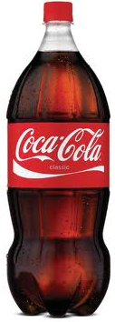
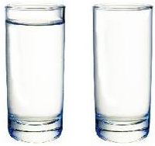
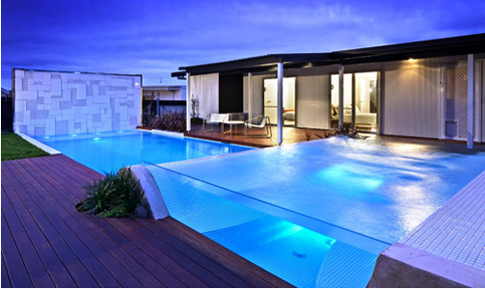
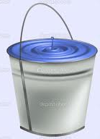
I) Volume of 3D Solids:
The volume of a 3D solid is the amount of space inside
For instance, if we have a cup, the volume is the amount of water inside
There are many real world applications with Volume
Amount of liquid in a container, pool, or bucket
Liquid can be measured in Litres and ml
Volume can be measured in: mm³ ,cm³, or m³
Conversion: 1cm³ = to 1ml
© Copyright all rights reserved to Homework depot: www.BCMath.ca

Slide 3
Volume of a Box:
Suppose you have a bin that measures 3cm by 4cm with a height of 5cm, how many 1cm³ boxes can you fit inside?
Another way to understand volume is to count the number of 1cm³ blocks that you can fit inside
So the volume of the larger box will be 60cm³ because you can fit 60 little 1-cm³ boxes inside
© Copyright all rights reserved to Homework depot: www.BCMath.ca

Slide 4
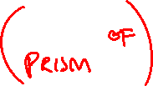
How to calculate volume?
One way to find the volume of a prism is to first find the area of the base in units² (ie: cm²,mm², or m²)
Then multiply the area of the base by the height of the prism
The height tells us how many layers there are
`
`
`
`
`
Suppose the area of the base is 24cm²
`
The height of each layer is 1cm tall
`
`
`
`
`
`
© Copyright all rights reserved to Homework depot: www.BCMath.ca

Slide 5
Ex: A box is 4cm wide, 5cm long, and 25cm high. How much liquid can it hold? Give your answer in millilitres.
First find the volume of the box in cm³
Get the area of the base:
Multiply the area of the base with the height
Find the volume in millilitres
© Copyright all rights reserved to Homework depot: www.BCMath.ca

Slide 6
Practice: Given the area of the base for each prism, find the volume of the solid:
© Copyright all rights reserved to Homework depot: www.BCMath.ca

Slide 7
Q: What is the volume of the following solid?
First find the area of the triangle at the base of the prism
Next, get the volume by multiplying the area of the base by the height of the prism
The volume of the triangle prism shown is 3600cm³

Slide 8
Q: Which solid has the greatest volume?
A
C
B
The volume of the third prism (Cube) is the largest with a volume of 2197cm³

Slide 9
Q: Which of the following would require to use of volume?
a) The amount of cloth to make a sweater : YES OR NO
The amount of cloth is related to surface area. So it does not require the use of volume
b) The amount of juice in a bottle : YES OR NO
The amount of juice is related to the space inside the bottle. So YES, it does require the use of volume
c) The amount of air to inflate a balloon : YES OR NO
The amount of air inside the balloon is the volume of the balloon. SO YES, it requires the use of volume
d) The amount of paint required to paint a wall: YES OR NO
Although the area of a wall is about surface area, the amount of paint is measured in liters. SO, therefore, the amount of paint required is related to volume. Answer YES

Slide 10
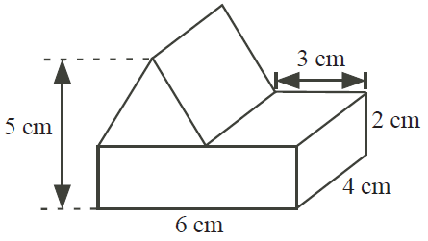
Ex: A triangular prism is placed on a rectangular prism as shown. What is the volume of the combined structure?
This solid can be split into two pieces. A triangular prism at the top and a rectangular prism on the bottom.
The volume of the prism is 84 cm³

Slide 11
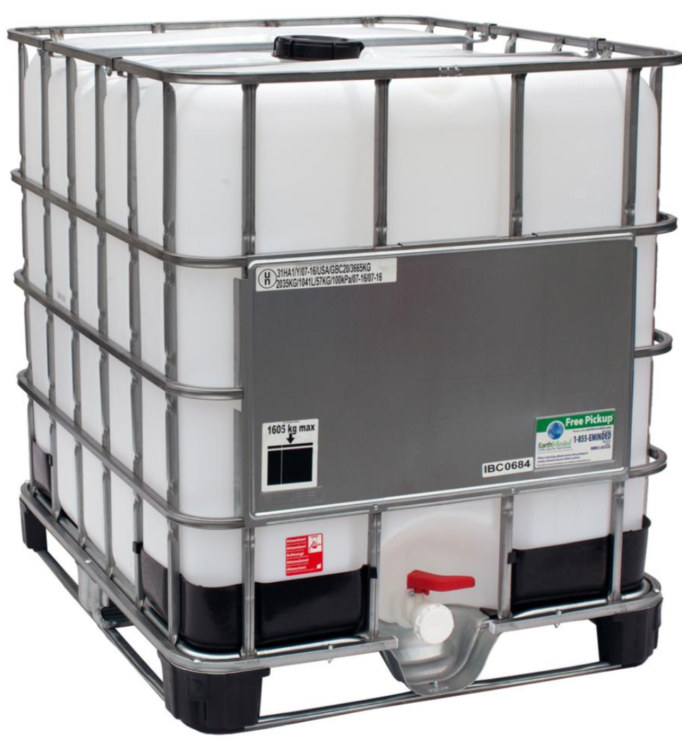
Ex: A water tank is 50cm by 50cm by 1.5m. How many litres of water can you store inside?
a) 101.5 Litres b) 2500 Litres
c) 3750 Litres d) 250 Litres
e) 375 Litres
Step 1: Get all the dimensions in “cm”
Length = 50cm
Width = 50cm
Height = 150cm
Step 2: Get the volume of the rectangular prism by multiplying the H x L x W
Step 3: Convert cm³ to ml. 1cm³ equals 1ml
Step 4: Convert ml to Litres. 1000 ml equals 1Litre
So divide your answer in ml by 1000 to get your answer in Litres

